Slide 1
Bank Marketing Campaign: Predictive Analytics
Members:
Diana Olulo - 1046050
Isaac Kinyanjui Ngugi- 1049049
Josephine Were - 1049083
Buheli Esther Taifa - 1049093
Brayan Mwangi-1049399
Abigael Kirimi - 1049507

Slide 2
Business Problem
Banks spend significant resources on marketing campaigns, but most calls end without success. This leads to wasted time, money, and reduced customer trust.
The main problem is how to predict which clients are more likely to subscribe to a term deposit, so that campaigns can be more targeted and cost-effective.
Stakeholders Include: Bank management,Marketing teams, Customers

Slide 3
Research Questions
What customer demographic and financial characteristics influence subscription decisions?
How do campaign-related variables affect customer response?
Can we build a model that accurately predicts whether a client will subscribe to a term deposit?
Which features are the most important for prediction?

Slide 4
Data Overview
Dataset: Bank Marketing – UCI Repository (bank-additional-full.csv)
Records: 45,211
Features: Age, job, marital status, education, default, balance, loans, contact type, campaign details, previous outcomes
Target: y = client subscription status
Yes → client subscribed
No → client did not subscribe
Purpose: Predict whether a client will subscribe to a term deposit

Slide 5
Data Collection: Bank Marketing dataset (41,188 records, 20 attributes)
Preprocessing: Handle missing values, encode categorical data, scale features, split train/test
Modeling: Logistic Regression, Random Forest, XGBoost
Evaluation: Accuracy, Precision, Recall, F1-Score
Insights: Feature importance analysis & campaign optimization recommendations
Methodology

Slide 6
Objectives
Main Objective: To build a predictive classification model that determines whether a client will subscribe to a term deposit.
Specific Objectives:
Perform data preprocessing (cleaning, handling missing values, encoding).
Conduct exploratory data analysis (EDA) to identify trends and patterns.
Provide conclusions and recommendations for banking decision-makers.

Slide 7
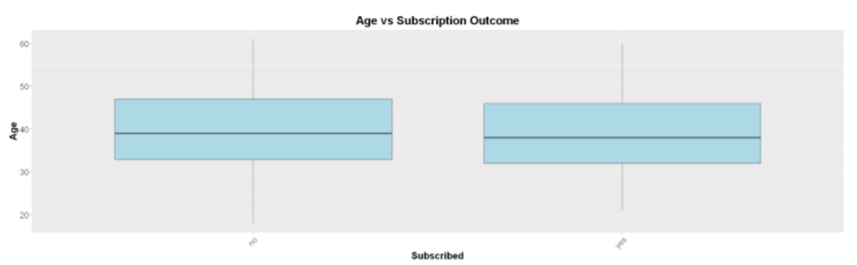
Research Question 1 – Customer Characteristics
Observations: Subscription rates are higher among middle-aged, married, and educated clients

Slide 8
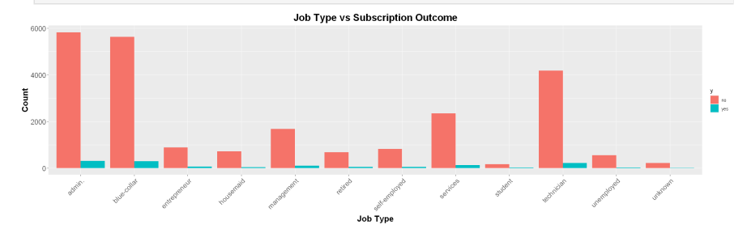
Research Question 1 – Customer Characteristics
Observations:
Blue-collar and management roles dominate in volume but have low-to-high subscription conversion.
Retired and unemployed groups show the lowest subscription interest.

Slide 9
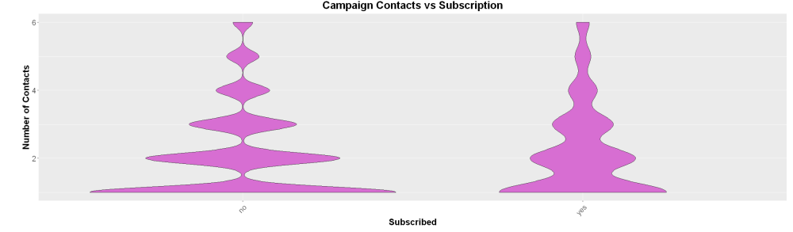
Research Question 2 – Campaign Variables
Most individuals received fewer contacts, with distributions concentrated around 1–2 contacts for both subscription outcomes. Subscribed clients show slightly more spread, suggesting that multiple contacts may improve conversion likelihood.

Slide 10
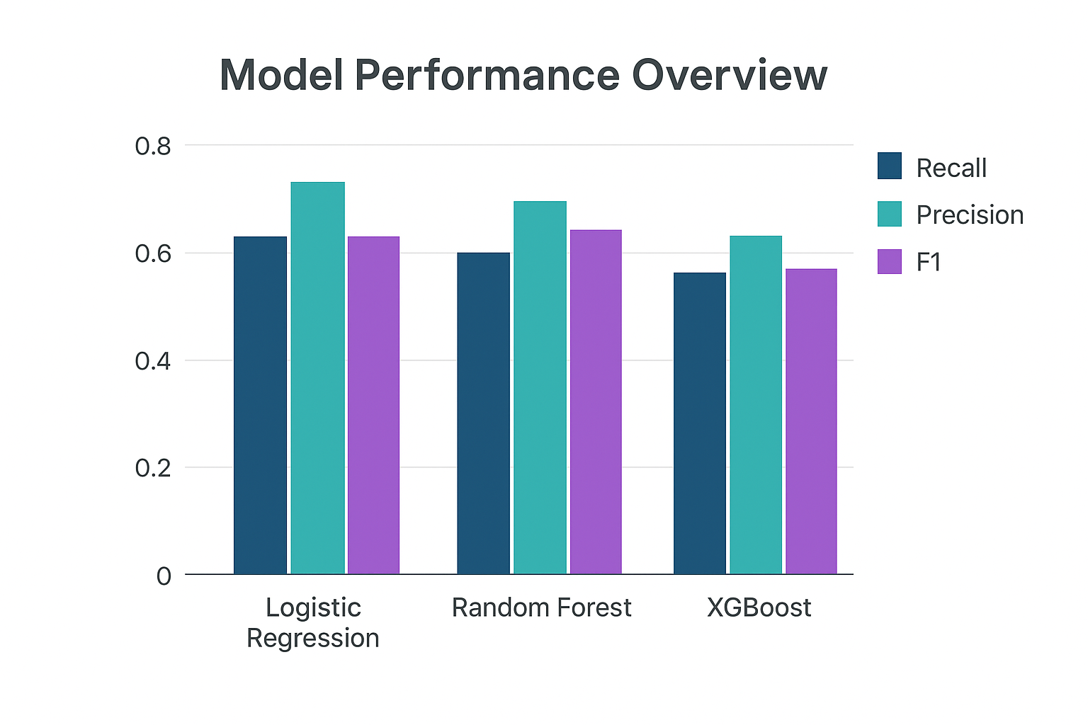
Model Performance and Evaluation

Slide 11
Model Selection
It gives the most balanced results overall.
It misses fewer important cases than Logistic Regression.
It is more reliable and consistent than XGBoost.

Slide 12
Conclusion
Customer Characteristics:
Age, education level, and financial status (e.g., housing or personal loan) influence subscription. More educated clients showed higher subscription likelihood.
Campaign Variables:
Contact duration and the number of recent contacts were strong predictors—longer and more recent interactions increased subscription chances.
Economic Factors:
Indicators such as employment variation rate and consumer confidence had subtle but notable effects on customer responsiveness.

Slide 13
Recommendations
Prioritize High-Probability Customers
Improve Contact Strategies
Focus on contacts that have longer durations or recent activity to increase engagement success.
Use Predictive Models in Campaigns
Integrate high-performing models like Random Forest into marketing workflows to optimize targeting and maximize ROI.
Optimize Timing Using Economic Signals

